Slide 1
„The Olympic ideals in ancient sport were destroyed by professionalism, in modern sport this threat is imposed by doping."
Z. Zajączkowski
THE FIGHT AGAINST DOPING - LEGAL BASIS
Renata Kopczyk

Slide 2
SPORT
- social and economic phenomen
- it affects the realization of the World strategic objectives, such as solidarity and prosperity
- it is the world’s biggest grassroots movement propagating active participation of citizens in social life
- developing area

Slide 3
SPORT
- commercialisation
- professionalisation
- interference of law

Slide 4
ETHICS
- Definition of ethics
rivalry in a fair-play atmosphere based on ethical reasons
- The most relevant documents on ethic in sport
Code of Sport Ethics (compiled by Council of Europe)
Olympic Charter (IOC Ethic Code – integral part of the Olympic Charter)

Slide 5
ETHICS
Code of Sport Ethics
Sports organisations and Governments have the following responsibilities:
- To publish clear guidelines on what is considered to be ethical or unethical behaviour and ensure that, at all levels of participation and involvement, consistent and appropriate incentives and/or sanctions are applied.
- To ensure that all decisions are made in accordance with a Code of Ethics for their sport which reflects the European code.
- To raise the awareness of fair play within their sphere of influence through the use of campaigns, awards, educational material and training opportunities. They must also monitor and evaluate the impact of such initiatives.
- To establish systems which reward fair play and personal levels of achievement in addition to competitive success.
- To provide help and support to the media to promote good behaviour.

Slide 6
ETHICS
IOC Ethic Code
Resptect to dignity as a core value of Olympic movement
Respect to honesty
Fight with doping
Spirit of fair play

Slide 7
DOPING
Definition:
Anti-Doping Convention:
“doping in sport” means the administration to sportsmen or sportswomen, or the use by them, of pharmacological classes of doping agents or doping methods
International Convention against Doping in Sport
doping is ”violation of anti-doping regulations”

Slide 8
DOPING
Definition:
International Convention against Doping in Sport
“Anti-doping rule violation” in sport means one or more of the following:
(a) the presence of a prohibited substance or its metabolites or markers in an athlete’s bodily specimen;
(b) use or attempted use of a prohibited substance or a prohibited method;
(c) refusing, or failing without compelling justification, to submit to sample collection after notification as authorized in applicable anti-doping rules or otherwise evading sample collection;
(d) violation of applicable requirements regarding athlete availability for out ofcompetition
testing, including failure to provide required whereabouts information and missed tests which are declared based on reasonable rules;
(e) tampering, or attempting to tamper, with any part of doping control;
(f) possession of prohibited substances or methods;
(g) trafficking in any prohibited substance or prohibited method;
(h) administration or attempted administration of a prohibited substance or prohibited method to any athlete, or assisting, encouraging, aiding, abetting, covering up or any other type of complicity involving an anti-doping rule violation or any attempted violation.

Slide 9
ANTY-DOPING POLICY
National regulations
International regulations
Inter-organization regulations

Slide 10
ANTY-DOPING POLICY
Anti-Doping Convention
Harmonizes international cooperation
Is obligation by the signatories
Two levels
it is open
International agreement
- International Convention against Doping in Sport
International agreement
Directly and indirectly supporting the assumptions World Anti-Doping Code
Actions on local level and international level
World Anti-Doping Code
Not international agreement

Slide 11
EUROPEAN UNION
Community support plan to combat doping in sport
White paper on sport
The Treaty of Lisbon
Case-law Court of Justice of the European Union (case c-519/04p, Meca Medina v. Commission)

Slide 12
THANK YOU FOR YOUR
ATTENTION
DIKKATİNİZ İÇİN TEŞEKKÜR EDERIM

Slide 13
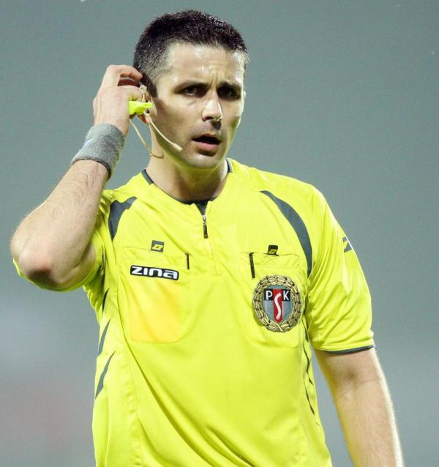
Any questions?

